Slide 1
Data Communications
Data Communications and Networking
Behrouz A. Forouzan, 5th Edition
McGraw-Hill
1-<number>

Slide 2
Part 1 Overview
Chapter 1 Introduction
1-<number>

Slide 3
Chapter 1. Introduction
Data communications
Networks
The Internet
Protocols and standards
1-<number>

Slide 4
Data Communications
Data
  Information presented in whatever form is agreed upon by the parties creating and using the data
Data communication
  Exchange of data between two devices
  Via some form of transmission medium
Fundamental characteristics of data communication
  Delivery
  Accuracy
  Timeliness
  Jitter : Variation in the packet arrival time
Telecommunication: communication at a distance
(‘tele’ in Greek=‘far”)
1-<number>

Slide 5

Five Components of Data Communication
Message: Information(data) to be communicated
Sender
Receiver
Transmission medium: Physical path by which a message travels
Protocol: A set of rules that govern data communication
1-<number>

Slide 6

Direction of Data Flow
1-<number>

Slide 7
Data Flow
Simplex
  Unidirectional
  As on a one-way street
Half-duplex
  Both transmit and receive possible, but not at the same time
  Like a one-lane road with two-directional traffic
  Walkie-talkie, CB radio
Full-duplex
  Transmit and receive simultaneously
  Like a two-way street, telephone network
  Channel capacity must be divided between two directions
1-<number>

Slide 8
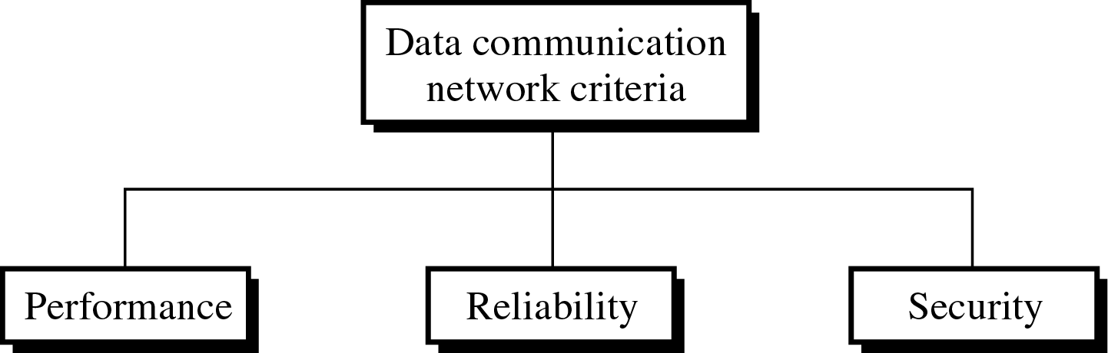
Network
Network: A set of devices (nodes) connected by communication links
Node: Computer, printer, or any device capable of sending and/or receiving data
To be considered effective and efficient, a network must meet a number of criteria
1-<number>

Slide 9

Type of Connection
1-<number>

Slide 10
Type of Connection
Point-to-point
  Dedicated link between two devices
  The entire capacity of the channel is reserved
  Ex) Microwave link, TV remote control
Multipoint
  More than two devices share a single link
  Capacity of the channel is either
    Spatially shared: Devices can use the link simultaneously
    Timeshare: Users take turns
1-<number>

Slide 11

Physical Topology
1-<number>

Slide 12

Mesh Topology
Dedicated point-to-point link to every other nodes
A mesh network with n nodes has n(n-1)/2 links. A node has n-1 I/O ports (links)
Advantages: No traffic problems, robust, security, easy fault identification & isolation
Disadvantages: Difficult installation/reconfiguration, space, cost
1-<number>

Slide 13

Star Topology
Dedicated point-to-point link only to a central controller, called a hub
Hub acts as an exchange: No direct traffic between devices
Advantages: Less expensive, robust
Disadvantages: dependency of the whole on one single point, the hub
1-<number>

Slide 14

Bus Topology
One long cable that links all nodes
tap, drop line, cable end
limit on the # of devices, distance between nodes
Advantages: Easy installation, cheap
Disadvantages: Difficult reconfiguration, no fault isolation, a fault or break in the bus stops all transmission
1-<number>

Slide 15

Ring Topology
Dedicated point-to-point link only with the two nodes on each sides
One direction, repeater
Advantages: Easy reconfiguration, fault isolation
Disadvantage: Unidirectional traffic, a break in the ring cab disable the entire network
1-<number>

Slide 16

Hybrid Topology
Example: Main star topology with each branch connecting several stations in a bus topology
To share the advantages from various topologies
1-<number>

Slide 17
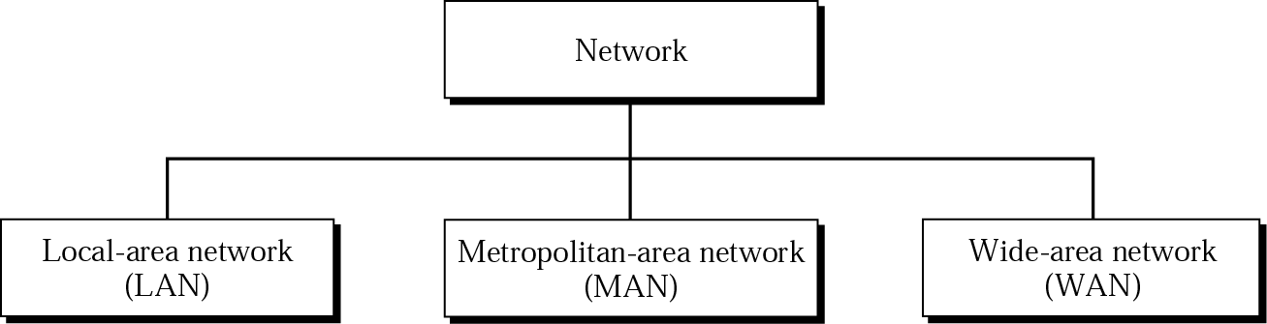
Categories of Networks
1-<number>

Slide 18

LAN
Usually privately owned
A network for a single office, building, or campus ≤ a few Km
Common LAN topologies: bus, ring, star
An isolated LAN connecting 12 computers to a hub in a closet
1-<number>

Slide 19
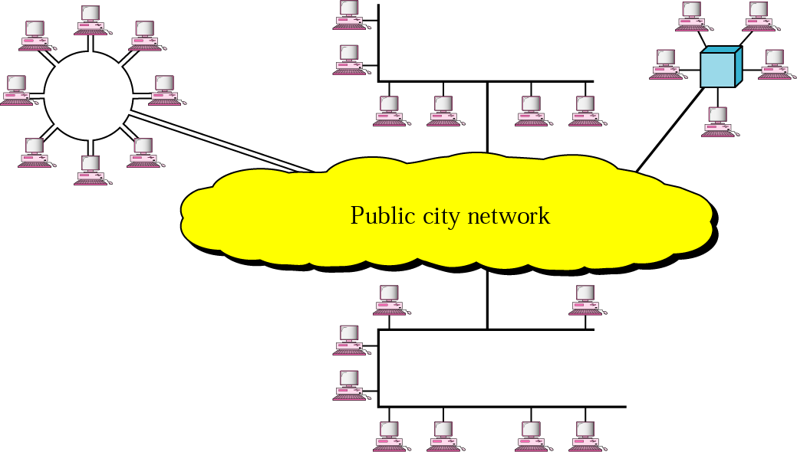
MAN
Designed to extend to an entire city
Cable TV network, a company’s connected LANs
Owned by a private or a public company
1-<number>

Slide 20

WAN
Long distance transmission, e.g., a country, a continent, the world
Enterprise network: A WAN that is owned and used by one company
1-<number>

Slide 21
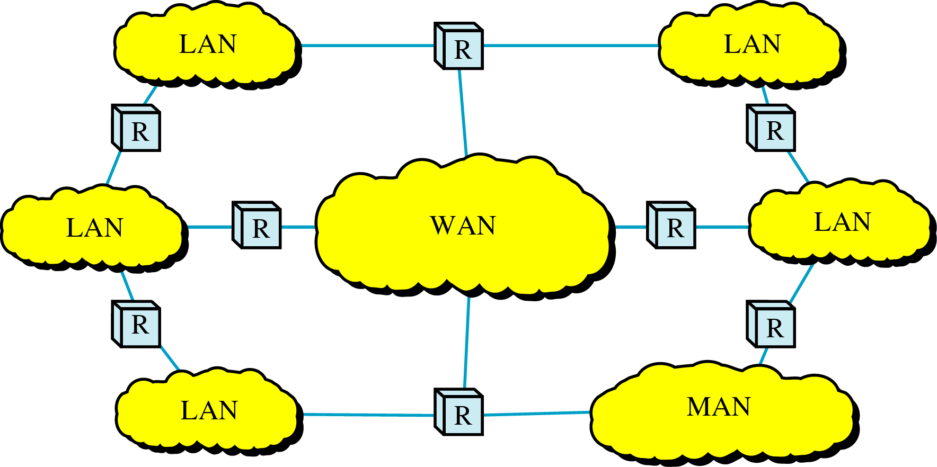
Internetwork
Internetwork (internet) : two or more networks are connected by internetworking devices
Internetworking devices: router, gateway, etc.
The Internet: a specific worldwide network
1-<number>

Slide 22

Internetwork Example
A heterogeneous network : four WANs and two LANs
1-<number>

Slide 23
The Internet
The Internet has revolutionized many aspects of our daily lives. It has affected the way we do business as well as the way we spend our leisure time. The Internet is a communication system that has brought a wealth of information to our fingertips and organized it for our use.
1967: ARPANET proposed by DoD’s ARPA(Advanced Research Project Agency)
1969: ARPANET in a reality: UCLA, UCSB, SRI, U. of Utah
1973: Vint Cerf and Bob Kahn propose TCP,
To split TCP into two protocols TCP and IP
1-<number>

Slide 24

Internet Today
ISP (Internet service providers)
NISP (national ISP)
NAP (network access point)
1-<number>

Slide 25
Protocols
Protocol : rule
  A set of rules that govern data communication
  For communication to occur, entities must agree upon a protocol
Key elements of a protocol
  Syntax: structure or format of data
  Semantics: meaning of each section in the structure
  Timing: when and how fast data should be sent
1-<number>

Slide 26
Standards: agreed-upon rules
Standards is essential in
  Creating/maintaining open and competitive markets
  Guaranteeing national/international interoperability
Two categories
  De jure (“by law” or “by regulation’) standards
  De facto (“by fact” or ‘by convention’) standards
    Proprietary standards: closed standards
    Nonproprietary standards: open standards
1-<number>

Slide 27
Standards Organizations
Standards are developed by
  Standards creation committees
  Forums
  Regulatory agencies
Standards committees & forums
  Standards committees are slow moving
  Forums are made up of interested corporations
  Forum are able to speed acceptance of a particular technology
1-<number>

Slide 28
Standards Committees
ISO
  Voluntary international organization
ITU-T
  Formerly, CCITT formed by UN
ANSI
  Private non-profit corporation in the US
IEEE
  The largest engineering society in the world
EIA
  Non-profit organization in the US
1-<number>

Slide 29
Internet Standards
IETF (Internet Engineering Task Force)
Internet Draft
  working document with no official status
  with a 6-month lifetime
RFC (Request for Comment)
  Edited, assigned a number, and made available to all interested parties
1-<number>

